Slide 1
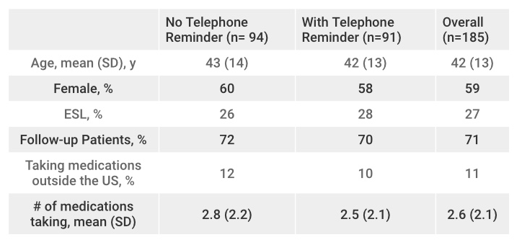
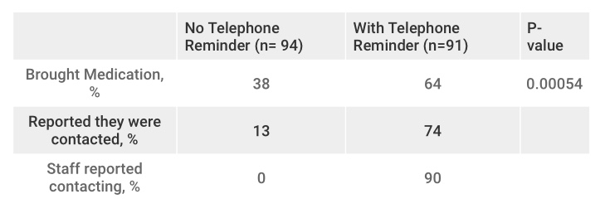
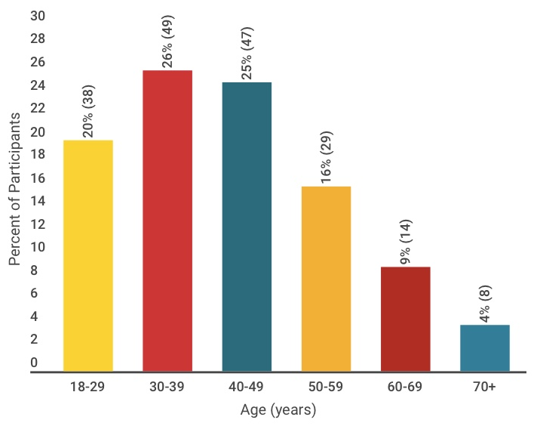
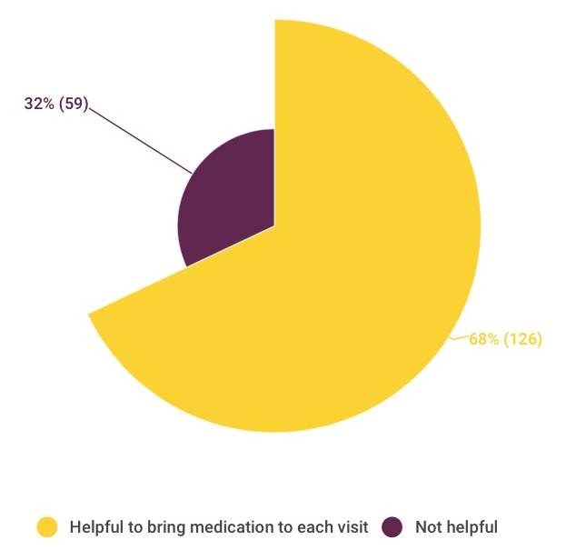
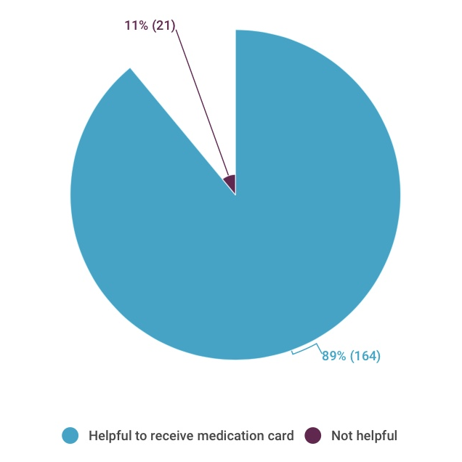
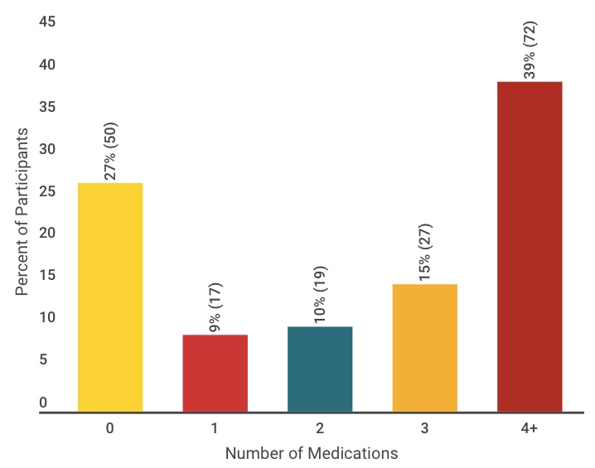
Enhancing the Accuracy and Completeness of Medication Reporting
Amrit S. Ahluwalia¹ BS; Hammad Khan¹ MPH; Shagufta Yasmeen¹ MD
¹UC Davis School of Medicine, Shifa Community Clinic
Background
Results
Results
Preventable adverse drug reactions is one of the leading causes of morbidity & mortality in healthcare.
Factors that complicate prescribing medications:
Polypharmacy- rate of ADRs increases exponentially after a patient is on four or more medications.
Medications prescribed by two or more doctors.
Medications obtained from various pharmacies, and outside the United States.
Particularly important in the community clinic setting. Typical community clinic patient is uninsured, underserved, and non-English speaking and often seen by a several health care providers.
Important first step in decreasing the rate of preventable adverse drug reactions is having an accurate and complete understanding of all medications & supplements patients are taking.
Table 1. Sociodemographic Characteristics
Table 2. Proportion of Patients Who Brought their Medications to the Appointment
Between the months of August 2016 through January 2017 a total of 185 participants completed the questionnaire.
94 patients prior to initiation of telephone reminders.
91 patients after the implementation of telephone reminders.
Table 1: Demographic information: Overall mean age was 42 ± 13 years, 59% female, and 27% non-native English speakers. 71% of participants were follow-ups, 11% were taking medications obtained outside the United States, and patients were taking an average of 2.6 ± 2.1 medications.
Prior to initiating telephone reminders 36 of the 94 patients (38%) bought in their complete medication list. After implementing the reminders 58 of the 91 patients (64%) brought in their complete medication list-- a statistically significant increase in medication completeness (Table 2).
Figure 3: 68% of patients felt it would be helpful to bring in their mediation and 89% felt it would be helpful to receive a card with all their medications.
Figure 1. Age Distribution of Participants
Figure 3. Participant Receptiveness to Medication Reporting
Methods
Study Population: All patients 18 years or older receiving care at Shifa Community Clinic between the months of August 2016 through January 2017.
Single center longitudinal research study.
Phase One: No intervention. Continue with appointment reminder call as usual. Shifa Medication Research Questionnaire asked at intake.
Phase Two: Intervention phase. During the standard appointment reminder call patients are now reminded to also bring in a complete list of all their medications & supplements and/or the medication bottles. Questionnaire asked at intake.
Conclusions
Figure 2. Current Number of Medications
This study successfully showed that implementing a telephone notification system increases the proportion of patients who bring in a complete list of all their medications & supplements and/or the bottles. Future studies should be aimed at quantifying how this intervention affects the rate of preventable adverse drug reactions/ medication errors in the community clinic.
Objective
Acknowledgments
To measure the effect of implementing a telephone notification system on the proportion of patients who bring in a current medication list.
We would like to extend our sincerest gratitude to Dr. Yasmeen for her mentorship and to the Shifa undergraduate staff for their dedication to this project and patient care.

